Slide 1
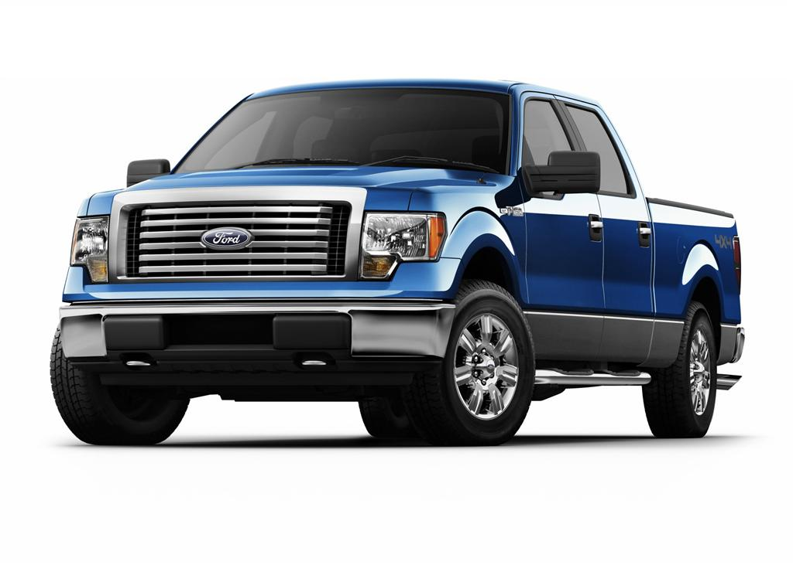
Driver Safety Program

Slide 2
PURPOSE
Address Safety
Achieve Accountability
Meet ORM and LPAA Requirements

Slide 3
Responsibilities Employees
Enroll and complete training within 3 months of employment, renew annually.
Adhere to the safety rules of the Driver Safety Program as well as all motor vehicle laws.
Submit fully completed travel request at least 24 hours beforehand.
Comply with the check in/check out procedures.
Fill out travel log completely.

Slide 4
Responsibilities Supervisors
Recommend employees for driver authorization only who have a genuine need to operate College vehicles.
Ensure that these employees have the opportunity to enroll in a Defensive Driving Training Course within three months of employment as required.
Approve travel requests.

Slide 5
Responsibilities Campus Site Manager
Ensure all necessary forms are kept in the glove compartment.
Maintain the State of Louisiana DA MV-3/MV4 Daily Vehicle Log Form (located in vehicle).
Approve Vehicle Requests.
Upon return of vehicle, ensure that keys and logs are returned, trip information is entered on the vehicle’s State of Louisiana DA MV-3 Daily Vehicle Log Form (located in vehicle), and the condition of the vehicle is checked.
Forward copies of vehicle log forms to Transportation Coordinator at the end of each month.

Slide 6
Responsibilities Transportation Coordinator
Ensure that all vehicles in the Delgado Fleet Vehicle Pool are in good mechanical condition with functional safety equipment.
Approve and maintain file of approved vehicle requests for one year.
Submit reports to appropriate departments and agencies.
Issue Fueltrac PIN numbers.

Slide 7
Who Is An Authorized Driver?

Slide 8
An Authorized Driver
A Delgado Employee
Authorized to operate vehicles for which there is a genuine job requirement and for which they are licensed and trained.
This determination shall be made annually.

Slide 9
Also
Delgado Advisors and consultants.
Members of boards, commissions and advisory councils.

Slide 10
How Do I Become An Authorized Driver?
Submit the following to the DCC Police Department
Authorization and Driving History Form (DA2054).
Defensive Driving Course certificate.
Both are located on the Police Department
webpage.

Slide 11
High Risk Drivers
Individuals having within the last 12 months
3 or more convictions, guilty pleas or no contest pleas for moving violations.
A single conviction, guilty plea or no contest plea for operating a vehicle while intoxicated, hit and run driving, vehicular negligent injury, reckless operation of a vehicle or similar violation.

Slide 12
Types of College Vehicles
Vehicles privately owned used in the course and scope of employment.
Vehicles owned by Delgado.
Vehicles rented or leased by Delgado.

Slide 13
Procedures for Privately Owned Vehicles
Drivers must have authorization to drive.
Reimbursements are approved in accordance with the College's Professional Leave and Travel policy.
Requests for reimbursement of routine field travel must be submitted to the Accounts Payable Office within two (2) weeks after the end of each month.
An LPAA MV7 form must submitted with each request.

Slide 14
PERSONAL VEHICLES Accidents
Do not assume responsibility for accident!
Call local police and supervisor immediately.
Fill out police report and get accident report number.
Complete State of LA Accident Report Form DA 2041.
Provide Transportation Coordinator with a copy.

Slide 15
Procedures for Fleet Vehicles
To request the use of a Delgado fleet vehicle, complete a Vehicle Request Form on
Located under the Resources Tab on the homepage.
No usernames or passwords required.
Fill out form completely.

Slide 16
The supervisor and/or campus site manager will receive an email for approval before final approval.
Once fully approved, an email will be sent to the requestor with check out and return instructions.
Keys can be picked up from the Transportation Coordinator or the campus site manager.

Slide 17
FLEET VEHICLES Rules and Regulations
Each fleet vehicle shall have a designated overnight storage site on campus.
All vehicles should have a travel log, Fueltrac card and paperwork located in the vehicle.
Each fleet vehicle shall have the appropriate Delgado Community College identification permanently affixed to both the driver and front passenger doors.
Unauthorized passengers should not be transported in College vehicles unless granted an exception by an supervisor.

Slide 18
Fuel/Repairs/ Service
The Transportation Coordinator will:
Issue a Fueltrac pin number for each driver.
Coordinate all services and repairs.

Slide 19
FLEET VEHICLES Accidents
Report any traffic violation or accident to supervisor, campus site manager and the Transportation Coordinator soon as possible.
Do not assume responsibility for accident.
Call local police immediately.
Request medical assistance, if required.
Protect against further damage.

Slide 20
FLEET VEHICLES Accidents
If out of town or after hours
Record details and images of accident, including extent of injuries or property damage, road and weather conditions, and how accident occurred.
Complete appropriate sections of the State of Louisiana Accident Report Form (Form DA 2041) as completely and accurately as possible at the scene of an accident
Provide supervisor and Transportation Coordinator with details of the accident and a copy of a completed Accident Report Form, upon return to Delgado.

